Slide 1
Capstone Project 2: Fake News Prediction

Slide 2
Business Problem Description –
In this era, where social media has so much dominance on knowledge and information across the globe, it is very important to identify if it is a fake or a genuine article, so that the knowledge and information is valuable and can a real education for the society.
With help of NLP (Natural Language processing), we will create a corpus of words from real and fake news articles. This corpus will be used to create a classifier model, which can predict the news/ article to be fake or real. With this model we can focus on the source of these articles and classify them with high confidence that the news or article coming from the source is real or fake.
Best prediction model with best parameter for future prediction of the fake news

Slide 3
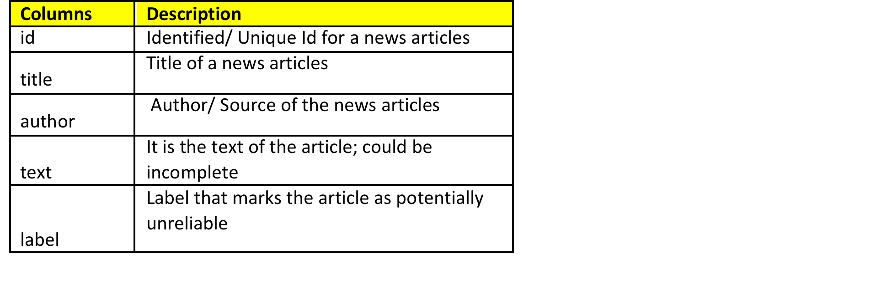
Dataset Details –
There are 20800 and 5 attributes. Key features from the dataset are as below from the training dataset

Slide 4
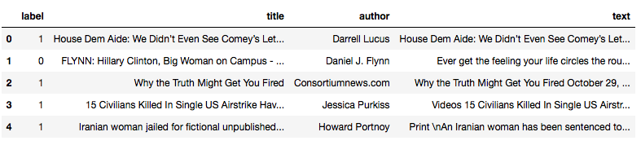
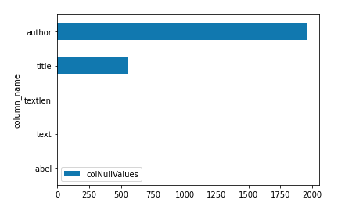
Data Wrangling –
We have downloaded the dataset provided on the Kaggle; and with our analysis of the data, there are 20800 records in the training dataset and 5200 records in the test dataset. This dataset set has the Author, Title, text and label as the attributes in the dataset
Data Preprocessing, steps will be performing for the text – attribute, Remove Line Breaks element, remove new Line element, remove Hyperlink element, remove ampersand, remove greater than sign, remove less than sign, remove non
Plotting the bar graph to see if check the null records in Author, Title and Text -
Around 1957 records are null for Author
Around 558 records are null for Title.
To handle the Null values, replaced Author and Title column as NA and dropped all the NA records. Also removed any text, which has less than 45 characters. Finally we are having 20563 records and 5 attributes.
As the dataset is ready, we have split the data between training and test data with 70:30 ratio. Created the Count Vector Training and Test dataset. Created the TFIDF train and test dataset for later in modeling section.

Slide 5
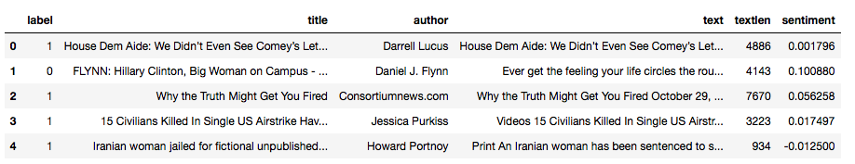
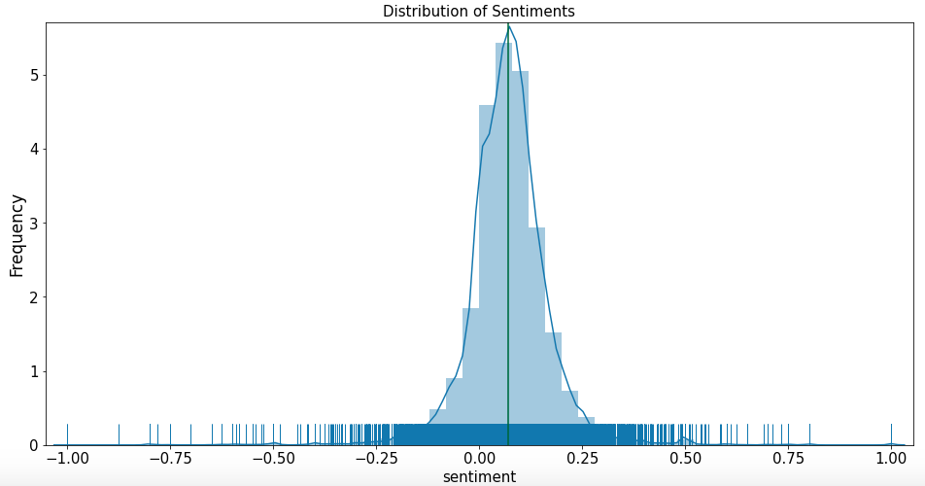
Data Visualization-
A new additional attribute is created to capture the sentiments from the text, used the sentiment polarity API to calculate the values. The values are calculated to -1 to 1, being 1 as positive sentiments and -1 as negative sentiments
Plotted the distribution of the sentiments score, it has close to normal distribution, as it seems, it has both positive and negative sentiments almost equally

Slide 6
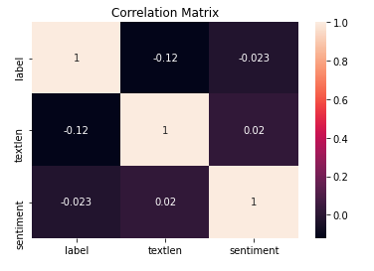
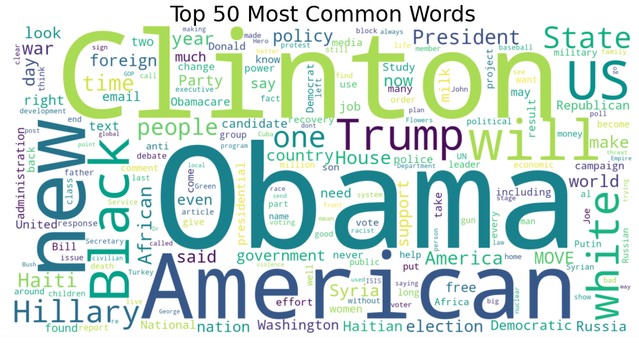
Correlation Plot & WordCloud-
correlation matrix, describing the relation between the attributes, the values of the correlation are between -1 and 1, showing positive and negative correlation. There is not strong correlation between any attributes, but there is a negative correlation of -0.12 between length and label
WordCloud from Train Dataset, creating the word cloud of 50 most common words are “Obama”, followed by “Clinton” and “American”.

Slide 7
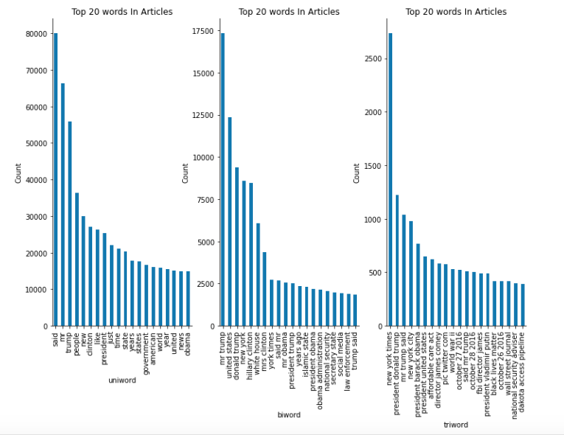
Ngarm Plot -
Creating the n-Gram plots for Unigram, Bigram and Trigram, in the unigram, the most common words after stopword are “said”, “mr” and “trump”. In the Bigram, we can see “mr trump”, “united states” and “donald trump”. In the trigram, we can see the common words are “new york times”, “president Donald trump ” and “mr trump said”

Slide 8
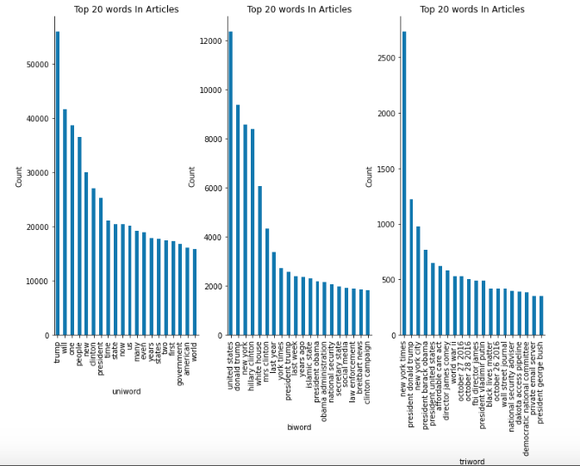
Ngarm Plot (Updated STOPWORD) -
Creating the n-Gram plots for Unigram, Bigram and Trigram, in the unigram, the most common words after stopword and updating stopword, are “trump”, “will” and “one”. In the Bigram, we can see “united states” and “donald trump” and “new york”. In the trigram, we can see the common words are “new york times”, “president Donald trump ” and “new york city”

Slide 9
Inferential Statistics
The dataset has 10385 fake news articles and legit/ valid news articles are 10178, out of total articles of 20563 records.
Calculate the T-Statistics of two independent sentiments sample from the population of fake news articles and real news articles. We have the below hypothesis –
Null Hypothesis – Both of the sample are same and equal, there is no difference in their sentiments analysis.
Alternate Hypothesis – Both of the samples are different and not equal and have difference in their sentiments analysis. The t-distribution left quartile range is: -1.9600793684470008. The t-distribution right quartile range is: 1.9600793684470004, as shown in fig14
T-stats =3.249, degree of freedom=20561, cv=1.645, p=0.001, alpha = 0.05.
Comparing the critical values to the t-stat, reject the null hypothesis that the means are equal.
Comparing the p-value to alpha, reject the null hypothesis that the means are equal.

Slide 10
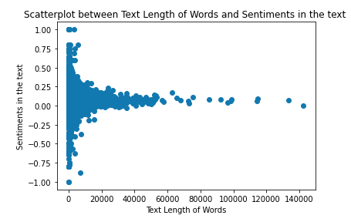
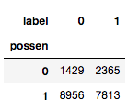
Inferential Statistics
Correlation between 'textlen' and ‘sentiment’:
Calculating for high correlation data from dataset, for 'textlen', 'sentiment', we find that the coeff values is 0.01971846321212139 and p-value is 0.004688487215723314. There is very less correlation (0.0197) between the text length and sentiments calculated.
Chi-Squared Test Statistics: A chi-square is goodness of fit validation to find out of the sample data matches the population. It tests for independence of two variables in a contingency table to find out if they are related. It determines weather distribution of the categorical variables differ from each other.
A small value of chi-square stats means that there is a relationship and observed data fits the expected data very well. A large value of chi-square test stats doesn't have any relationship and observed data doesn't fit the expected data.
Null Hypothesis (H0): The sample with sentiment analysis and fake news are independent of each other.
Alternate Hypothesis (H1): The sample with sentiment analysis and fake news are not independent of each other.
Created the new column as positive sentiments in the dataset. Created a new view by grouping Sentiment and fake and real news, After applying the chi-square test, we found the below results
Stats =306.143 and pvalue=0.000 and dof=1
Expected
[[1916.09638671 1877.90361329]
[8468.90361329 8300.09638671]]
We can conclude that we can reject the Null Hypothesis of sentiments and fakes news are independent of each other. There is a clear deviation
The Fake news tends to have negative sentiments compared to real news which has most of positive sentiments.

Slide 11
Model Building and Implementation
The training dataset is created for COUNT vectors, TF-IDF vectors. In this section, we need to develop a model to predict fake or legit news based on the historical data collected in the training set with labels.
Two methods – CountVectorizer and TF-IDF Vectorizer, are used as Count Vectorizer provides the document term matrix, which is transposed tokens, or words in features with count of occurrence of each word.
Model created for Logistics Regression with Count Vectors, Logistics Regression with TF-IDF Vectors, Multinomial Naïve Bayes classifier with Count Vectors with hyper parameter and Multinomial Naïve Bayes classifier with TF-IDF Vectors with hyper parameter. The hyper parameter tuning is done using “GridSearchCV”. The Best parameters resulted as alpha = 0.1.

Slide 12
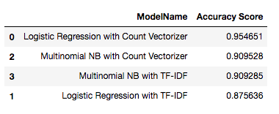
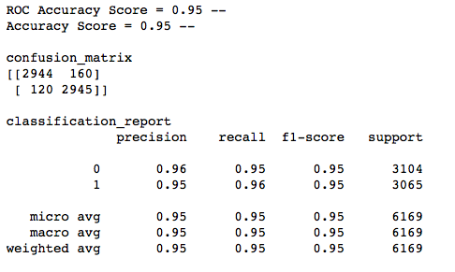
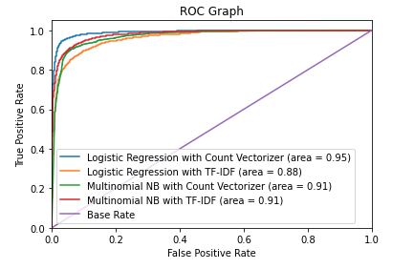
Models Performance-
Accuracy scores of each of the algorithms.
Best results from the above accuracy score is of – Logistic Regression with Count Vectors. Below we can see the ROC Accuracy is 0.95.
In the confusion matrix, as shown in fig16
True positive is 2944 and True Negative is 2945.
Type I – False negative is 120 and Type II – False positive is 160.
We can see that Logistic Regression with Count vector has highest AUC-ROC score of 95%.

Slide 13
Conclusion -
There are 20800 records in the training dataset and 5200 records in the test dataset. There are 10413 records, which are labeled as real / valid news and 10387 records are labeled as fake news.
Data Preprocessing, was performed on text – attribute with, remove Line Breaks element, remove new Line element, remove Hyperlink element, remove ampersand, remove greater than sign, remove less than sign, remove non-breaking space, remove Emails, remove new line characters, remove distracting single quotes.
Created the Count Vector Training and Test dataset with split of 70:30 ratio
“n-Gram” plots for Unigram, Bigram and Trigram, in the unigram, the most common words after stopword and updating stopword, are “trump”, “will” and “one”. In the Bigram, we can see “united states” and “donald trump” and “new york”. In the trigram, we can see the common words are “new york times”, “president Donald trump ” and “new york city”.
T-Statistics of two independent sentiments sample from the population of fake news articles and real news articles. T-stats =3.249, degree of freedom=20561, cv=1.645, p=0.001, alpha = 0.05. Comparing the critical values to the t-stat, reject the null hypothesis that the means are equal. Comparing the p-value to alpha, reject the null hypothesis that the means are equal.
Models created for Logistics Regression with Count Vectors, Logistics Regression with TF-IDF Vectors, Multinomial Naïve Bayes classifier with Count Vectors with hyper parameter and Multinomial Naïve Bayes classifier with TF-IDF Vectors with hyper parameter. The hyper parameter tuning is done using “GridSearchCV”. The Best parameters resulted as alpha = 0.1.
Best results from the above accuracy score are of – Logistic Regression with Count Vectors with ROC Accuracy is 0.95 or AUC-ROC score of 95%.

